Slide 1
STORAGE ACCOUNT
An Azure Storage Account is a secure account, which provides you access to services in Azure Storage. The storage account is like an administrative container, and within that, we can have several services like blobs, files, queues, tables, disks, etc. And when we create a storage account in Azure, we will get the unique namespace for our storage resources. That unique namespace forms the part of the URL. The storage account name should be unique across all existing storage account name in Azure.
Hot storage: It is optimized for storing data that is accessed frequently.
Cool Storage: It is optimized for storing data that is infrequently accessed and stored for at least 30 days.
Azure Storage Replication
Azure Storage Replication is used for the durability of the data. It copies our data to stay protected from planned and unplanned events, ranging from transient hardware failure, network or power outages, and massive natural disasters to man-made vulnerabilities.
Azure creates some copies of our data and stores it at different places. Based on the replication strategy.

Slide 2
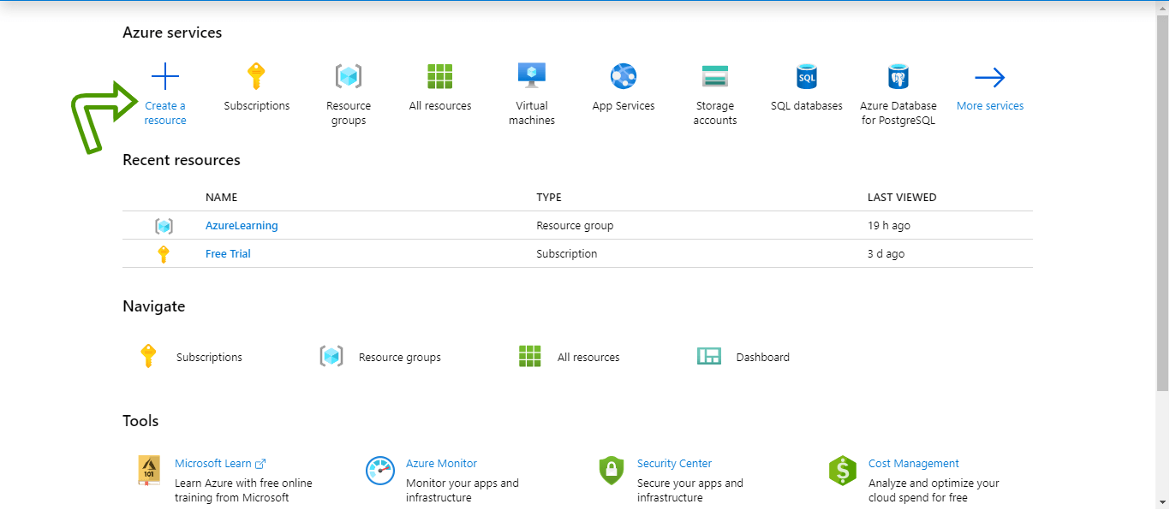
Creating and configuring Azure Storage Account
Login to your Azure portal home screen and click on "Create a resource". Then type-in storage account in the search box and then click on "Storage account".

Slide 3
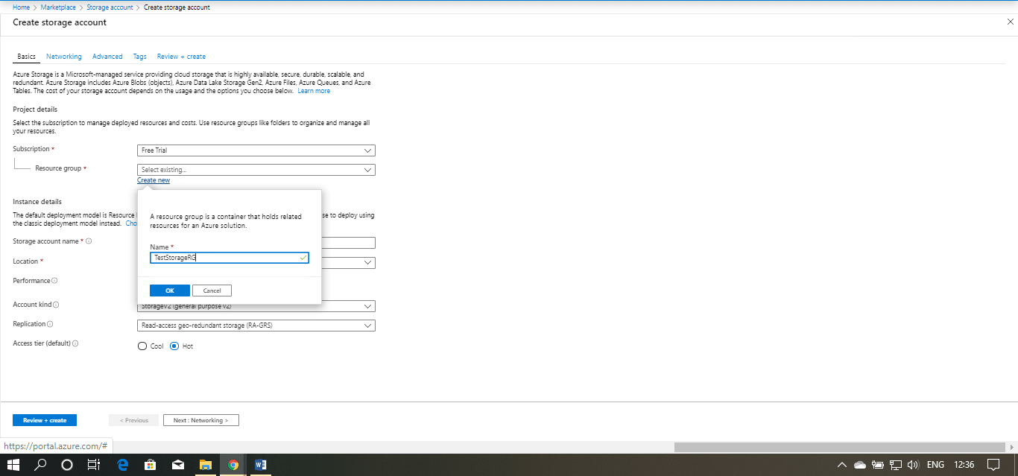
Click on create, you will be redirected to Create a storage account window.
First, you need to select the subscription whenever you are creating any resource in Azure, and secondly, you need to choose a Resource Group. In our case, the subscription is "Free Trail".
Use your existing resource group or create a new one. Here we are going to create a new resource group.

Slide 4
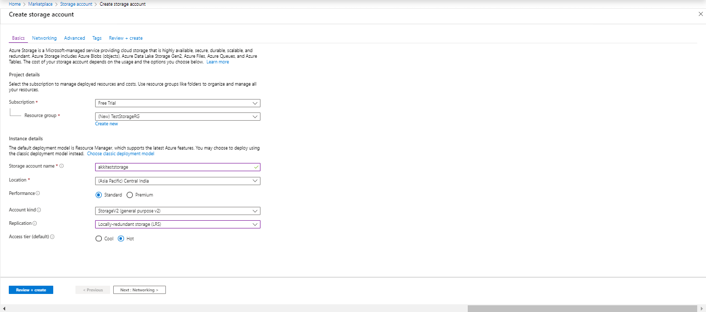
Then, fill the storage account name, and it should be all lowercase and should be unique across all over Azure. Then select your location, performance tier, Account kind, Replication strategy, Access Tier, and then click on next.

Slide 5
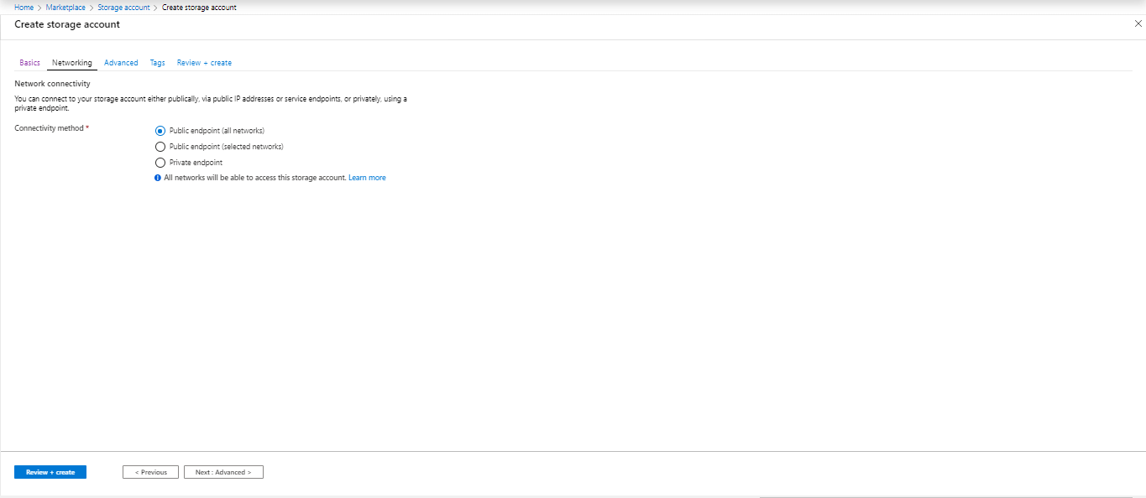
You are now on the Networking window. Here, you need to select the connectivity method, then click next.
You are now on the Advanced window were you need to enable or disable security, Azure files, Data Protection, Data lake Storage and then click next.

Slide 6
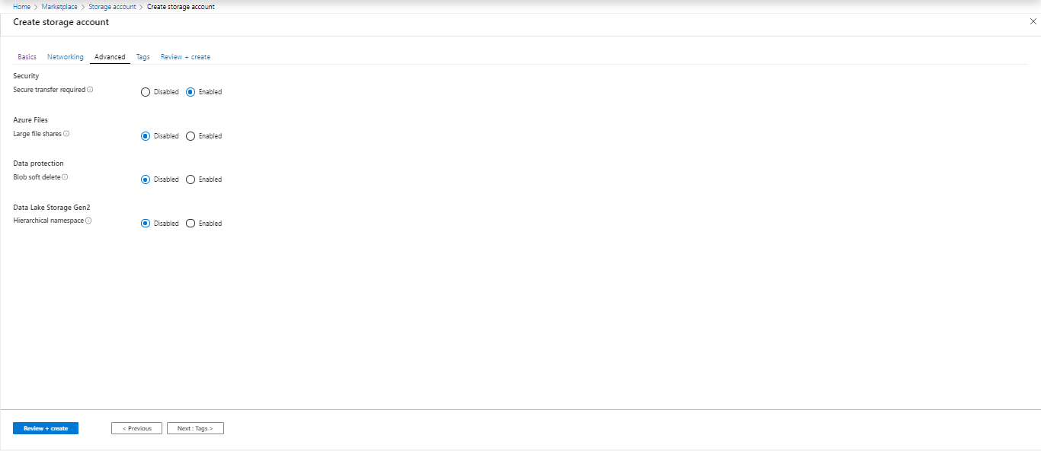
Now, you are redirected to the Tags window, where you can provide tags to classify your resources into specific buckets. Put the name and value of the tag and click next.

Slide 7
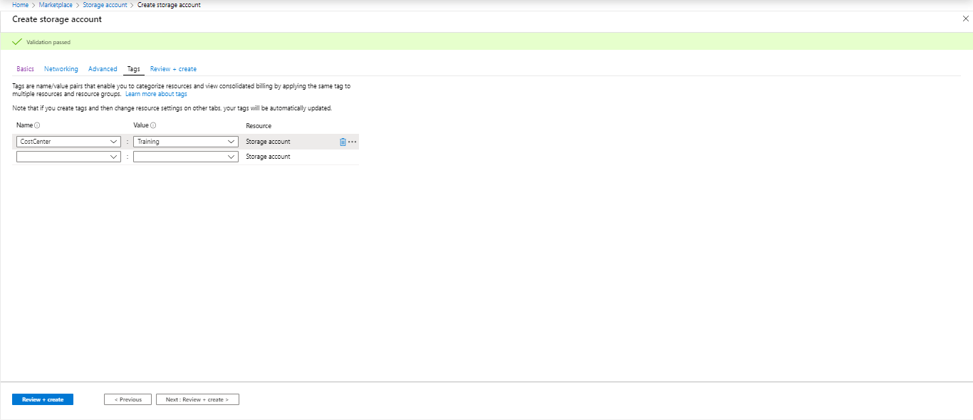
This is the final step where the validation has been passed, and you can review all the elements that you have provided. Click on create finally.

Slide 8
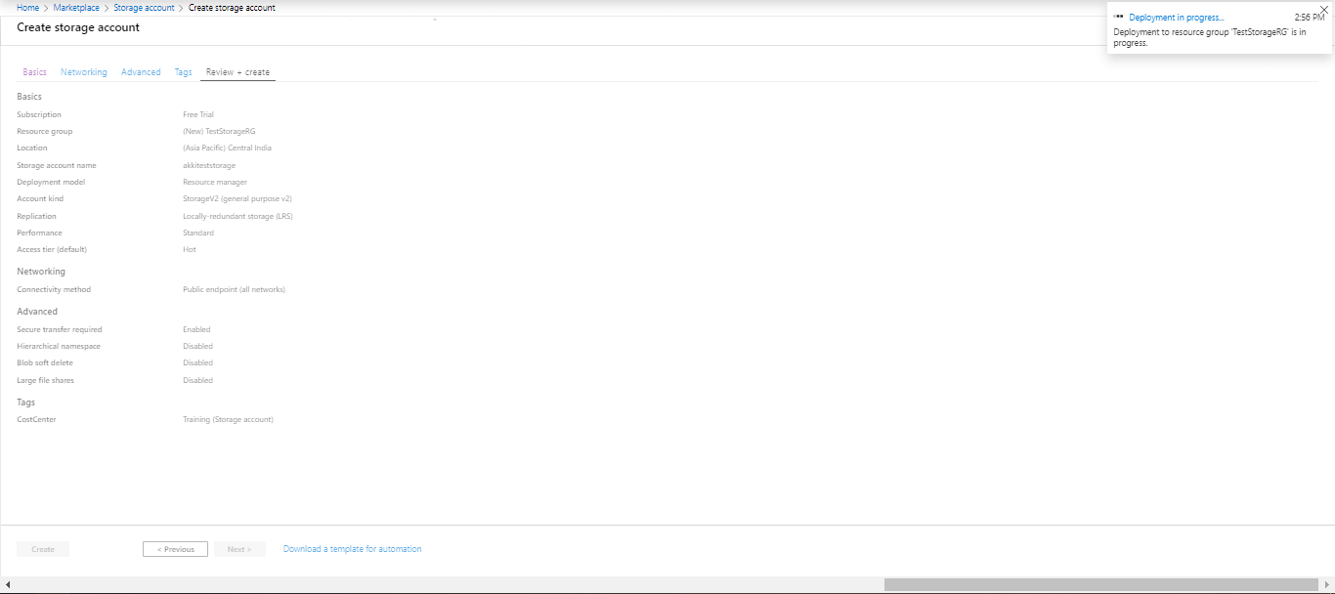
Now our storage account has been successfully created, and a window will appear with the message "Your deployment is complete".

Slide 9
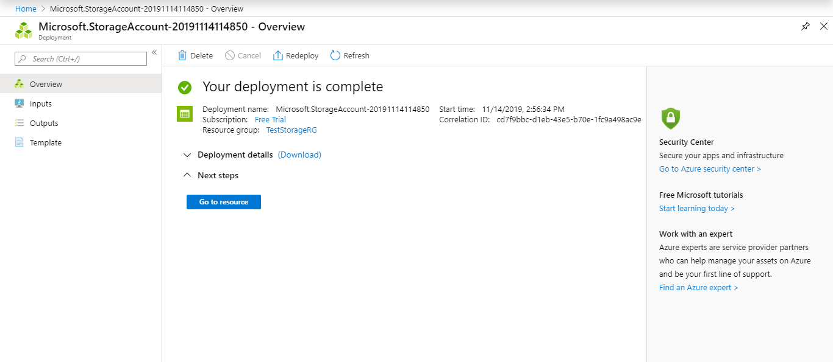
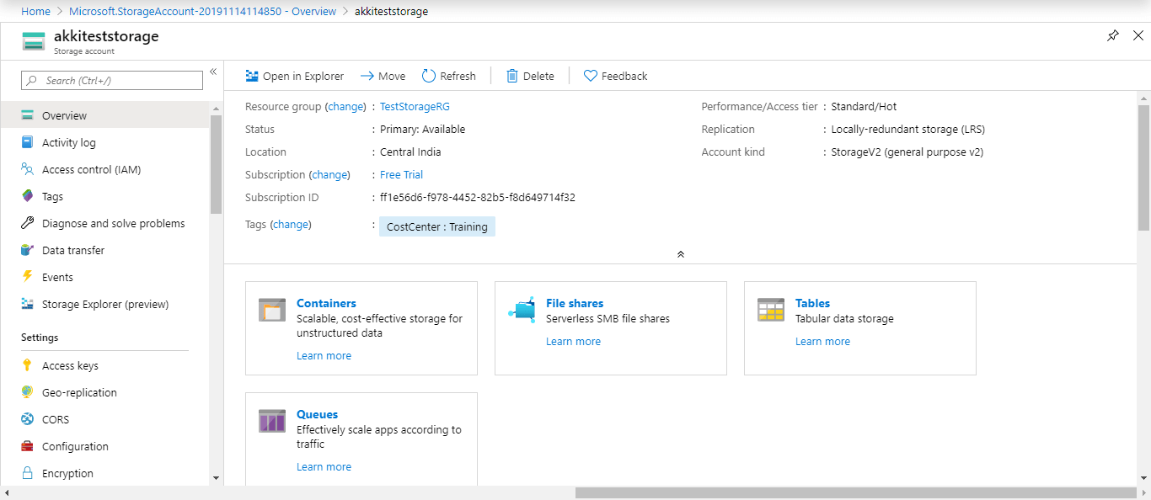

Slide 10
CORS (Cross-Origin Resource Sharing): Here, we can mention the domain name and what operations are allowed.
Azure Web Apps is a cloud computing based platform for hosting websites, created and operated by Microsoft. It is a platform as a service (PaaS) which allows publishing Web apps running on multiple frameworks and written in different programming languages (.NET, node.js, PHP, Python and Java), including Microsoft proprietary ones and 3rd party ones.
App Service not only adds the power of Microsoft Azure to your application, such as security, load balancing, auto scaling, and automated management.
You can also take advantage of its DevOps capabilities, such as continuous deployment from Azure DevOps, GitHub, Docker Hub, and other sources, package management, staging environments, custom domain.
Create a Azure web app
To publish your web app, you must first create and configure a new App Service that you can publish your app to.
As part of setting up the App Service, you'll create:
A new resource group to contain all of the Azure resources for the service.
A new Hosting Plan that specifies the location, size, and features of the web server farm that hosts your app.

